Slide 1
Using Micro-Reviews to Select an Efficient Set of Review
Date : 2014/01/14
Author : Thanh-Son Nguyen,
Hady W. Lauw ,
Panayiotis Tsaparas
Source : CIKM’13
Advisor : Jia-ling Koh
Speaker : Shao-Chun Peng

Slide 2
Outline
Introduction
Method
Experiments
Conclusion

Slide 3
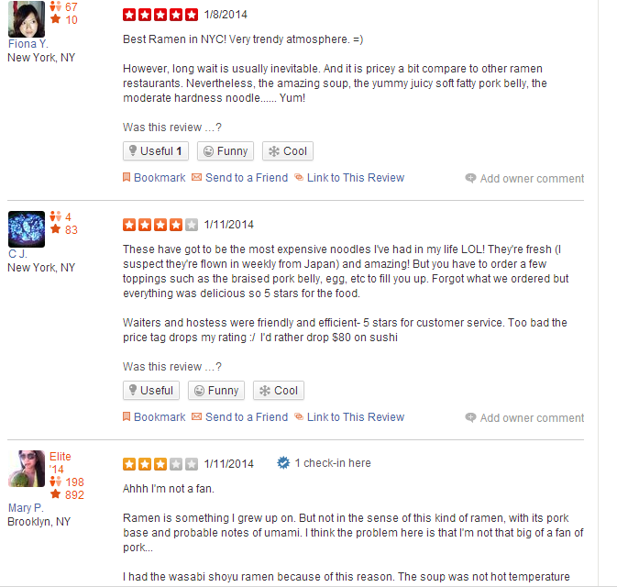
Introduction
Motivation
We can find ample review in Web sources, but which are better to show the experiences of customer

Slide 4
Introduction
Reviews:
unstructured, lengthy, verbose
From Web(e.g. Yelp, Amazon.com)
Micro-reviews(tips):
short, concise, focused
From micro-blogging (e.g. Facebook, Twitter)

Slide 5
Purpose
Bring together these two diverse type of review content, to obtain something that is more than the sum of its part

Slide 6
Framework
pairs
Reviews
Matching review and tip
Syntactically
Semantic
Sentiment
Algorithm
EffMaxCover
tips
α
output
β
Set of reviews
k

Slide 7
Outline
Introduction
Method
Experiments
Conclusion

Slide 8
Syntactically similarity
A review sentence and a tip are syntactically similar if they share important keywords
SynSim(s; t) = cosine(s; t)
Compute s and t with standard tf-idf in corpus
tf-idf
a:0.5
b:0.3
c:0.7
d:0.1
e:0.3
f:0.2
s:abcd
Vector s={0.5, 0.3, 0.7, 0.1, 0,0}
t:cdef
Vector t={0, 0, 0.7, 0.1, 0.3, 0.2}

Slide 9
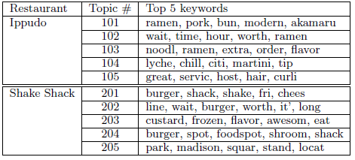
Semantic similarity
A review sentence and a tip are semantically similar, when they are describing the same concept
SemSim(s; t) = JSD(θs; θ t)
θs , θt : probability distribution over the topics
JSD: compute probability similarity
pre-process: LDA classify

Slide 10
Sentiment similarity
A matching pair of review sentence and tip should also represent the same sentiment
SentSim(s; t) = polarity(s) × polarity(t)
maximum entropy classier (MEM)
P(C+|d)+P(C-|d) = 1 [0,1]
polarity(s)= 2P(C+|d)-1 [-1,1]

Slide 11
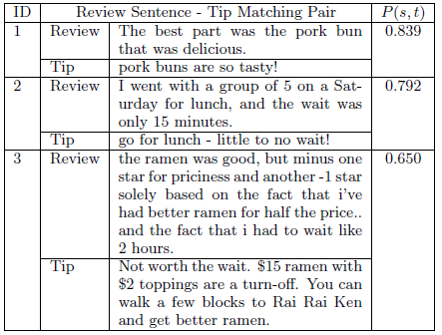
Matching Function
Binary classification framework
Syntactically similarity
Semantic similarity
Sentiment similarity

Slide 12
Coverage
Review: R
Tips: T
Sentence :s
Coverage(R)=|T_{R}|

Slide 13
Efficiency
Review: R
Tips: T
Sentence: s

Slide 14
Merger Coverage
Cov(S)=|U_{RЄS} T_{R} |
Normalized: Cov(S)/|T|

Slide 15
Merger Efficiency
More involve than Coverage
Minimum
Average
Bag
View a collection S as a single review consisting of the union of sentences

Slide 16
EffMaxCover
Bi-criterion optimization problem
NP-hard
Constraining efficiency , max coverage
Eff(S)>=α find the max coverage

Slide 17
Algorithm
Greedy approach
Gain(R)=Cov(S U R) - Cov(S)
Cost(R)=β(1-EFF(R))+(1- β)
For each round add the max Gain(R)/Cost(R) to the set

Slide 18
Outline
Introduction
Method
Experiments
Conclusion

Slide 19
Data set
March 2012
110 restaurant in New York (delete tip<=50)
102 restaurant
96612 reviews (584~3460)
14740 tips (51~498)

Slide 20
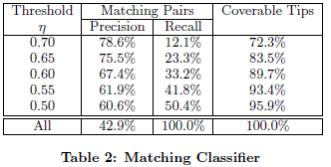
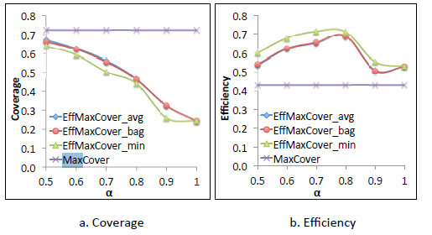
Experiments

Slide 21
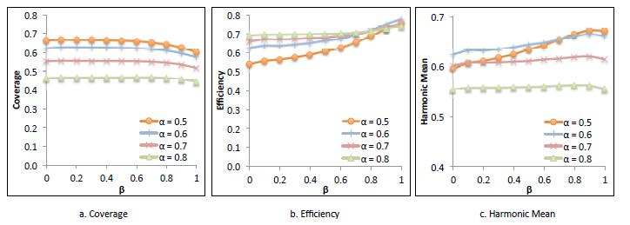
Experiments
β
is an effective way to gain eff with min loss in cov

Slide 22
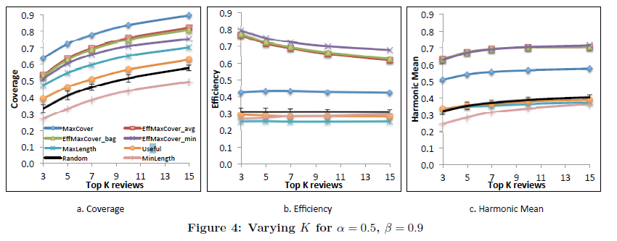
Experiments

Slide 23
Outline
Introduction
Method
Experiments
Conclusion

Slide 24
Conclusion
Use micro-review for finding an efficient review set
Design EffMaxCover to the selection problem

